Slide 1
Row Level Security
Using Power BI

Slide 2
Row Level Security
It’s a way to restrict access to the data for a specific User.
For example: A sales company has a business over 3 cities:
Los Angeles – Rockville – Dale City.
Your colleague wants to see data only for Los Angeles.
How to set this up?

Slide 3
RLS Process
start by creating a rule [City] = “Los Angeles”
On Power BI desktop,
Open the dashboard – Go to modeling
Click on “Manage Roles” – Select “Create”
Rename the role: “Los Angeles”

Slide 4
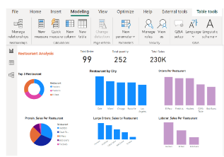
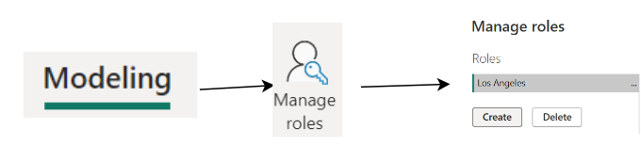
RLS Process

Slide 5
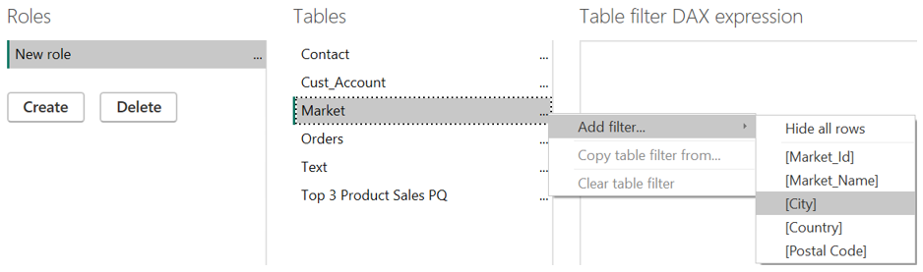
RLS Process
Choose the table where to apply: “Market”
Add filter [City] = “Los Angeles”

Slide 6
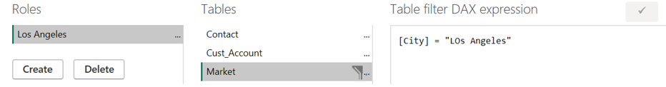
RLS Process
Check the [Ok icon] to make sure there are No DAX Errors
And then save it.

Slide 7
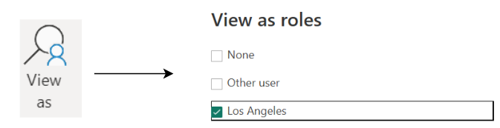
RLS Process
Before publishing to the service,
Go to view As and select “Los Angeles”

Slide 8
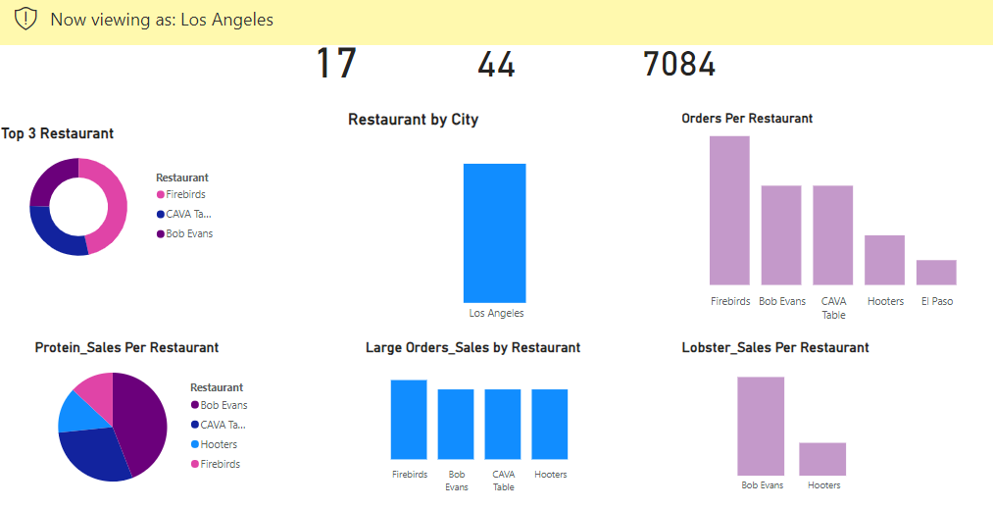
RLS Set Up
The row level security has been set up

Slide 9
Publish to Power Bi Service
Publishing to the service allow others users to view the report.
Remember your colleague want to see data only for Los Angeles.
Here is how to proceed:
Save the report
Click on “Publish” – Validate credentials

Slide 10
Publish to Power Bi Service
On the workspace - Click on “Row Level Security”
On RLS dataset – select “Security”
In the New pop up window, in the member section: “Add your colleague
email Address”
Click on “Add”, Then save to apply change
Now you can let know your colleague that the report is ready to be viewed!

Slide 11
Thanks For Reading
Don’t forget to comment and Add more insights

